Slide 1
Project 4: Most Popular Movies
Lyndsay Wylie, Kim Engelhardt, Kirsten Zalobsky, Ben Raseman, Nick Ezop, Mike Dake
03/9/2023
72
#4

Slide 2
Project Proposal
-Take a look at the top rated movies from 1990 until 2017
-Loop in highly rated TV shows
-Create a ChatBot that recommends a movie based off of user input
-Use Tableau to visualize what the big data is saying

Slide 3
Extract. Transform. Load.
ETL
DataFrame Clean-up and Loaded in Postgres

Slide 4
Data Source
Kaggle
What kind of data source was it : csv file
*MovieLens data set
-movies_metadata.csv

Slide 5
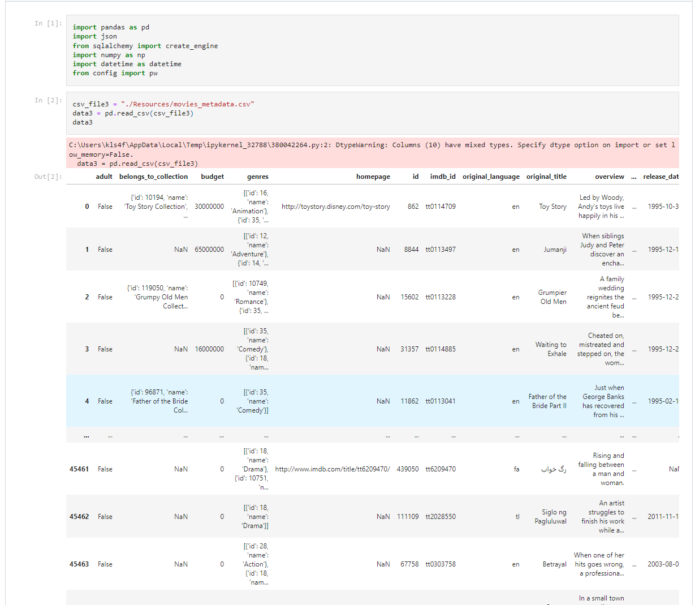
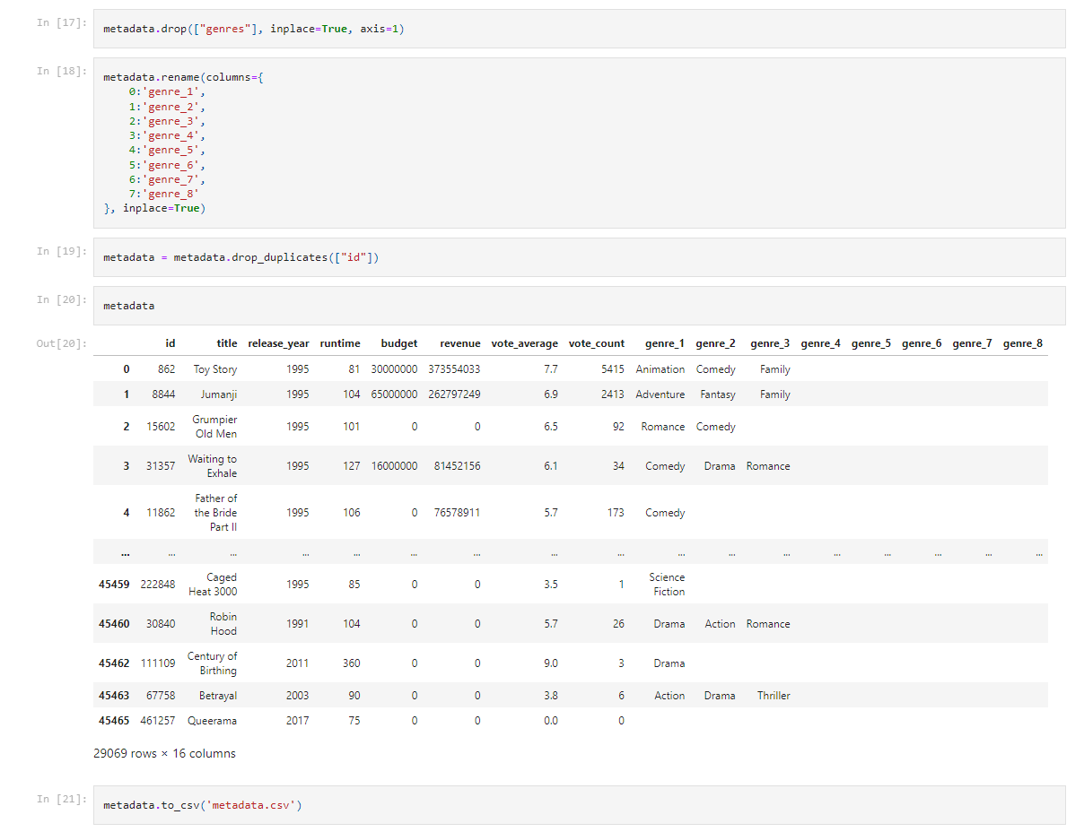
How it Started & How it Ended

Slide 6

Visualizations

Slide 7
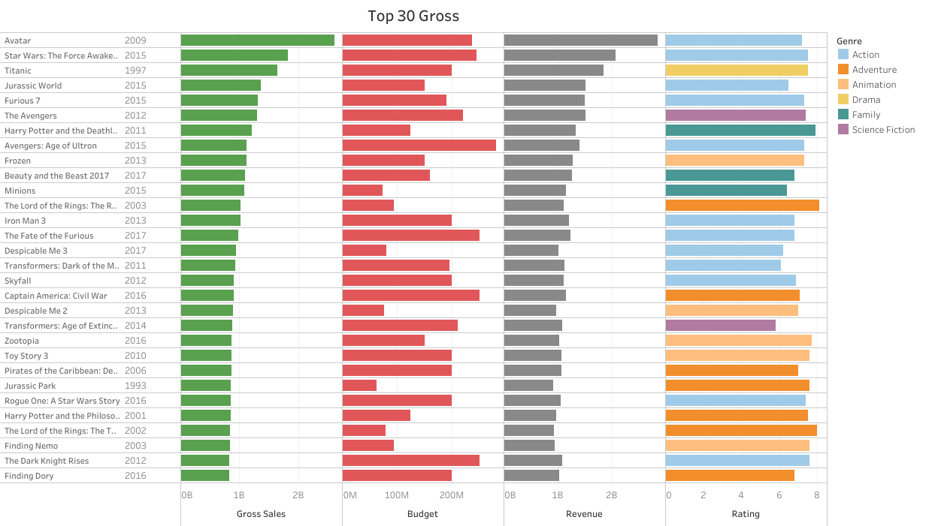
Did you know?
The top grossing movie genre isn’t the most popular?

Slide 8
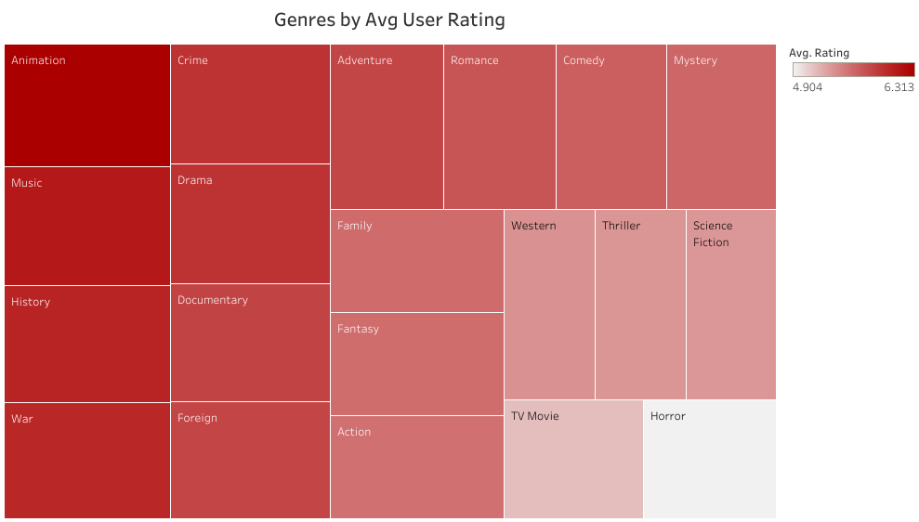
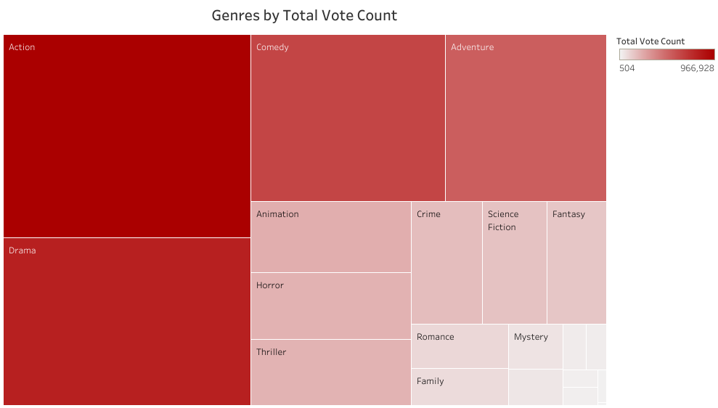

Slide 9
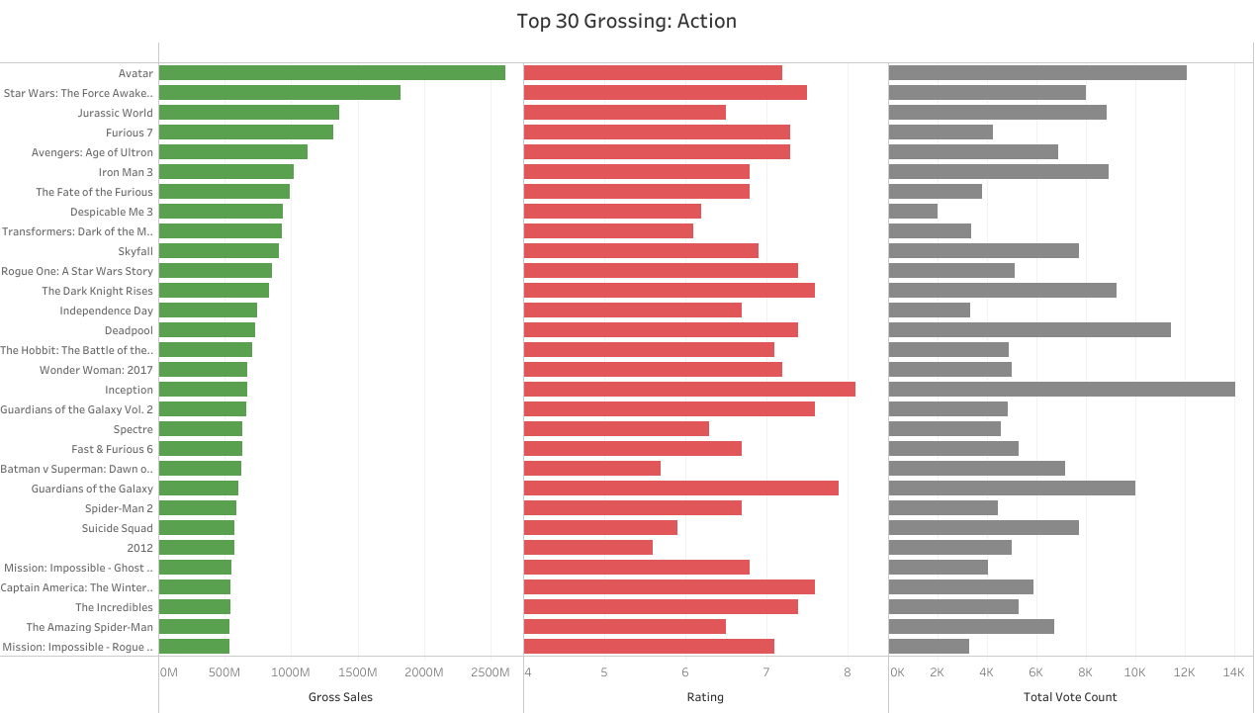

Slide 10
Machine Learning
Overview
Optimization
For our Machine Learning model, we chose to create one neural network to predict a movies average rating based on genre, and another neural network to predict average user rating based on a specific movie title.
Filtered movie dataset by only using reviewers with over 100 ratings
Filtered genre dataset by dropping userId duplicates to make sure there was only one average rating per user
Initial Results
Final Results
Our initial models were trained on the Action genre and the movie title Legend. The genre model achieved an accuracy score of 0.812, and the movie title model achieved an accuracy score of only 0.30.
Genre model increased accuracy score to 0.9892
Movie model increased accuracy score to 0.974

Slide 11
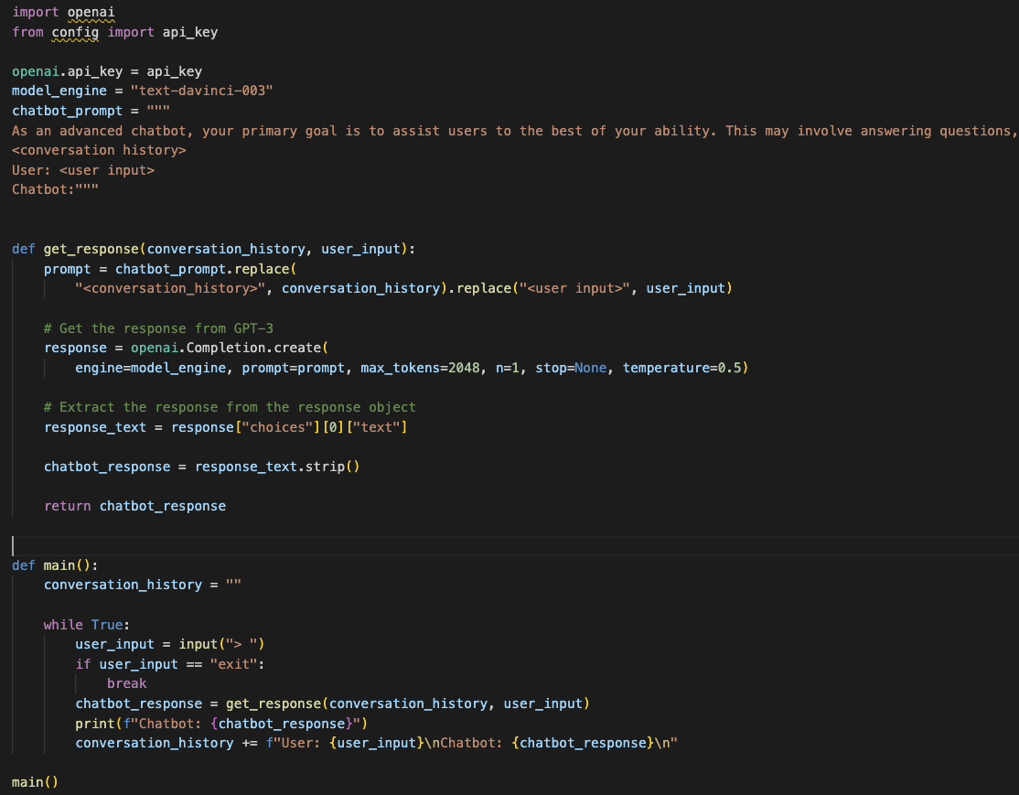
ChatBot
Development
Deployment
Made a call to OpenAI’s API to access their data
Created 2 different functions:
get_response() uses the conversation history and user input to determine the chatbot’s output
main() asks for the user input and calls get_response and prints the output. The conversation history is saved.
Unable to deploy chatbot to website.
Since the website had already been built, we didn’t want to rebuild it around a Flask powered API with the short amount of time we had.

Slide 12
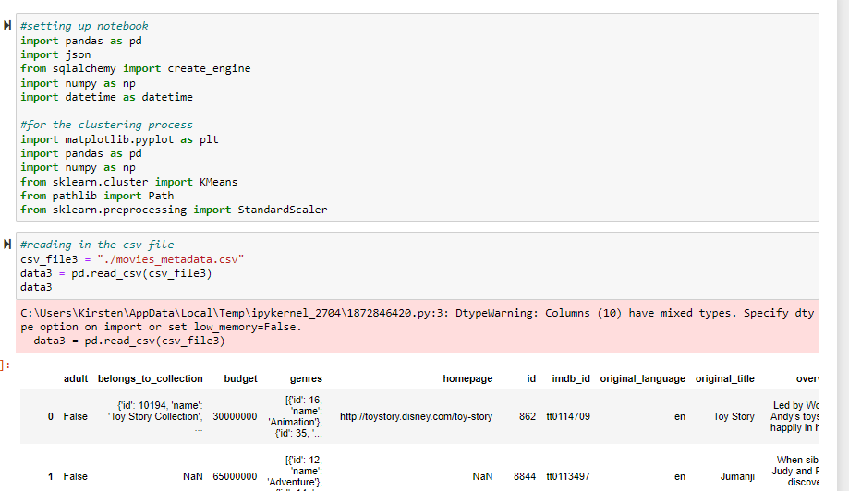
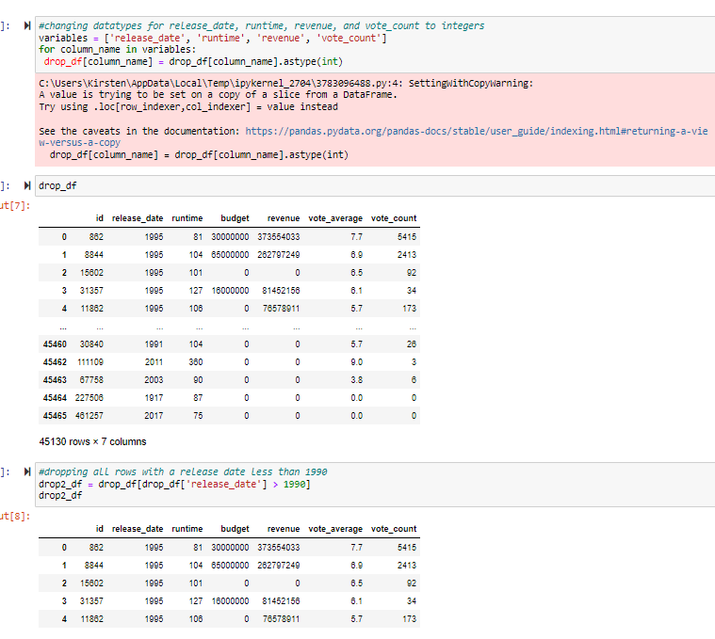
KMeans and Clustermapping - What Affects Vote Average?
Setting up notebook and reading in the CSV
Refining dtypes and dropping years before 1990

Slide 13
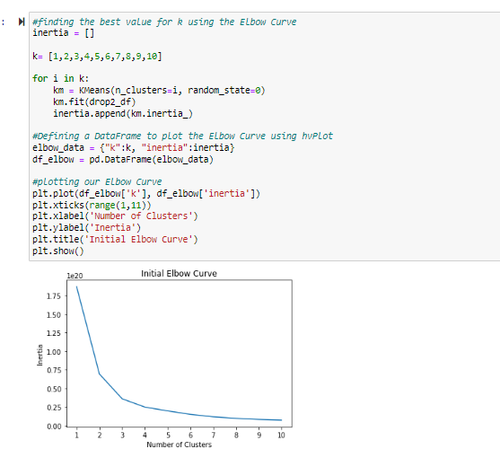
Initial Elbow Curve
Initial elbow curve to see the number of clusters (5)

Slide 14
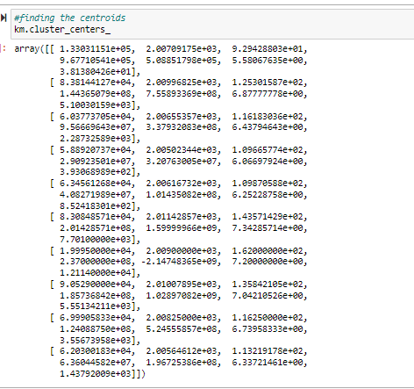
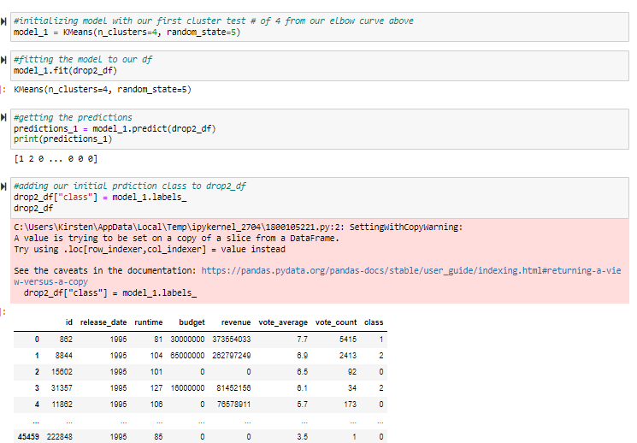
Finding Centroids & Using KMeans
Generating the model and classifying the outcomes
Using KMeans to find the centroids of our clusters

Slide 15
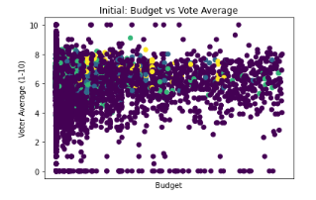
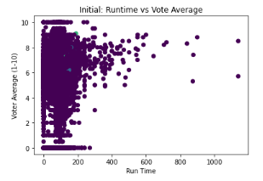
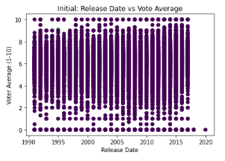
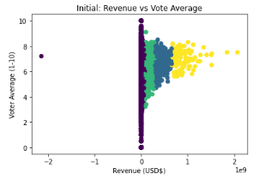
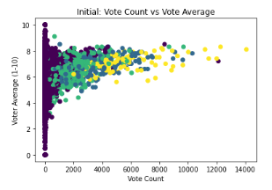
Initial Cluster Mapping
Does Vote Average depend on any of our chosen factors?

Slide 16
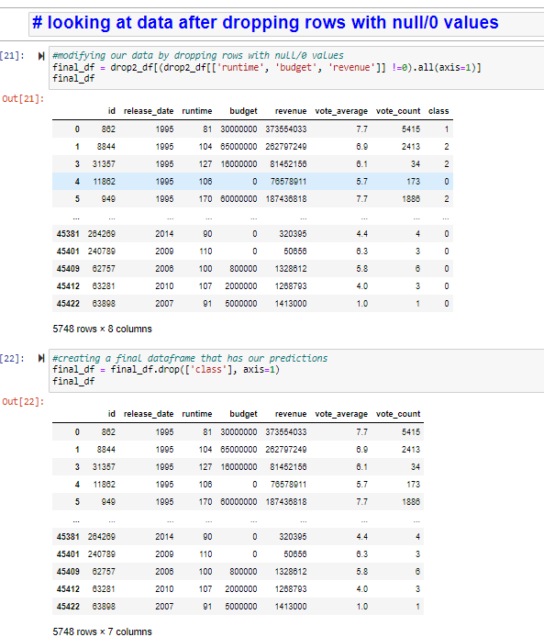
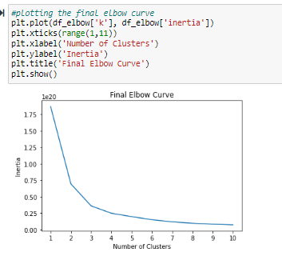
Refining the Data
Dropping rows with “0” values
Checking on Number of Clusters after refining the data (5)

Slide 17
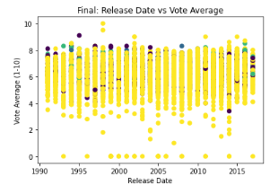
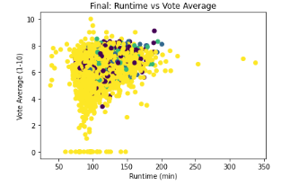
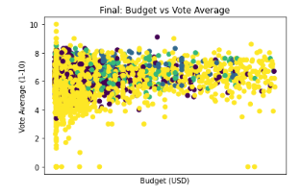
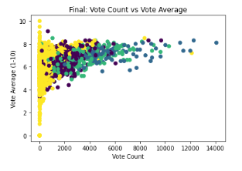
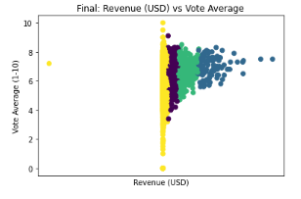
Final Cluster Mapping
Final cluster mapping after dropping the rows

Slide 18
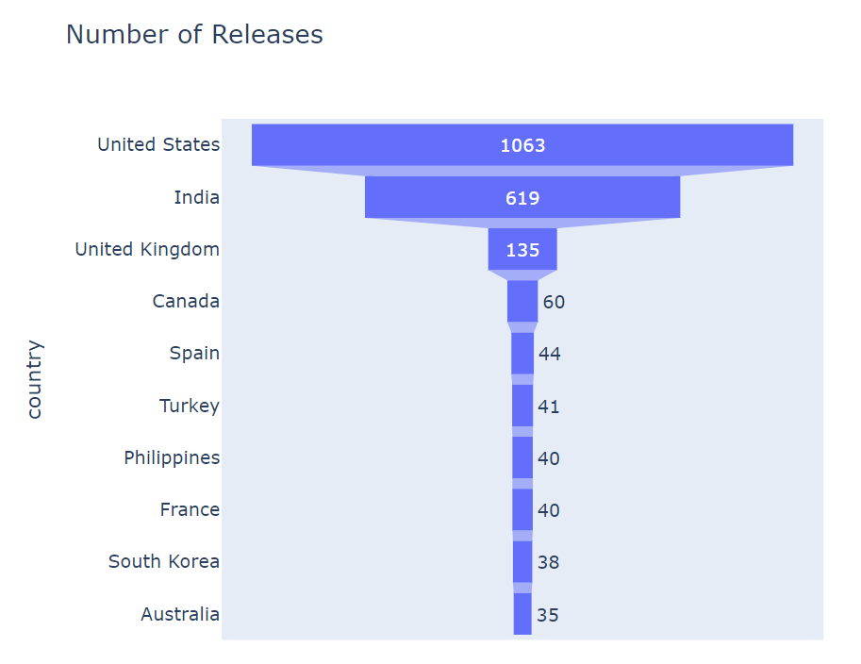
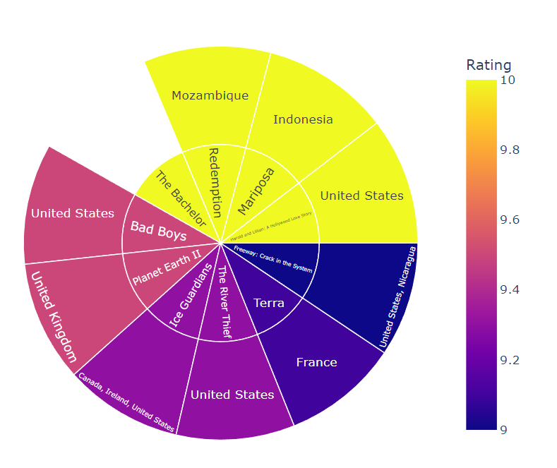
Content by Countries
The United States, India, and
the United Kingdom release
the most content.
The highest rated movies come
from the United States, France,
and the United Kingdom.
Data Source: kaggle

Slide 19
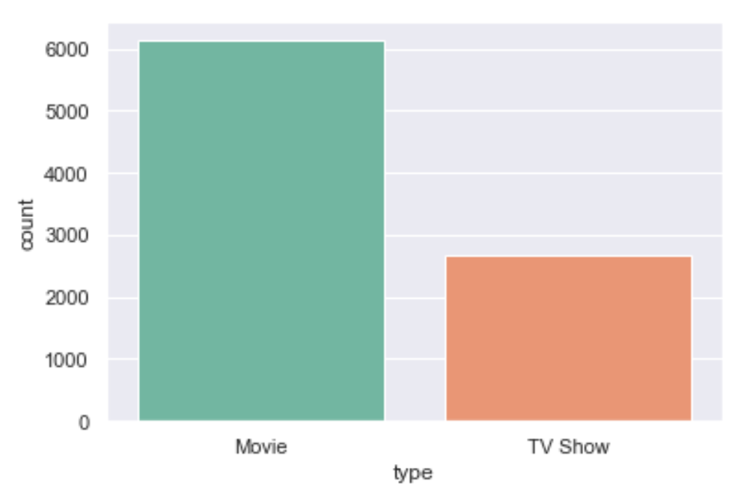
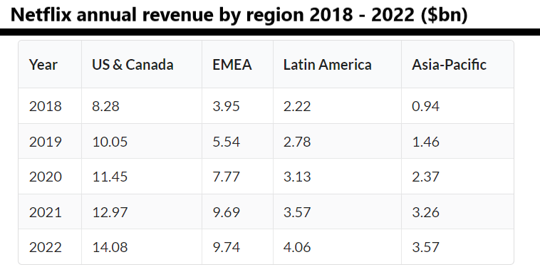
Netflix currently has over 6,000 movies and less than 3,000 series in its catalog, indicating people prefer watching movies over tv series.

Slide 20
Thank you!
Questions?

